Slide 1
Detect and Classify Carton Boxes in Warehouses
Team Micheal Ezekiel
Reference: https://dlabs.ai/blog/how-artificial-intelligence-is-transforming-diabetes-care/

Slide 2
Agenda
Detection Algorithm
Process
Challenges
Datasets Explored & Training Experiments
Observations from Integration Meeting
Future RoadMap
References

Slide 3
Detection Algorithm
1

Slide 4
Two Stage Networks Vs Single Shot Detection
Two Stage Networks
Single Shot Detection
Object detection methods that splits into region selection and region classification which Improves the accuracy by first identifying potential object locations and then refining those predictions
Examples: R-CNN(Regions with Convolutional Neural Networks), Fast R-CNN
Single Shot Detection (SSD) refers to object detection method that achieve both object classification and localization in a single forward pass through the network
Examples: YOLO(You Only Look Once), RetinaNet

Slide 5
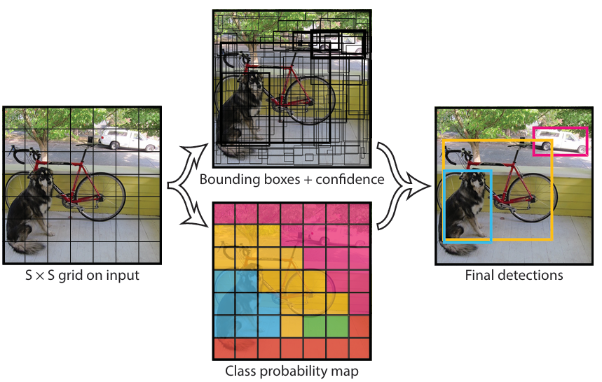
YOLO Algorithm
It divides the image into an SxS grid
For each grid cell, predicts
B bounding boxes
confidence for those boxes, and
C class probabilities
These predictions are encoded as an SxSx((B*5)+C)tensor.

Slide 6
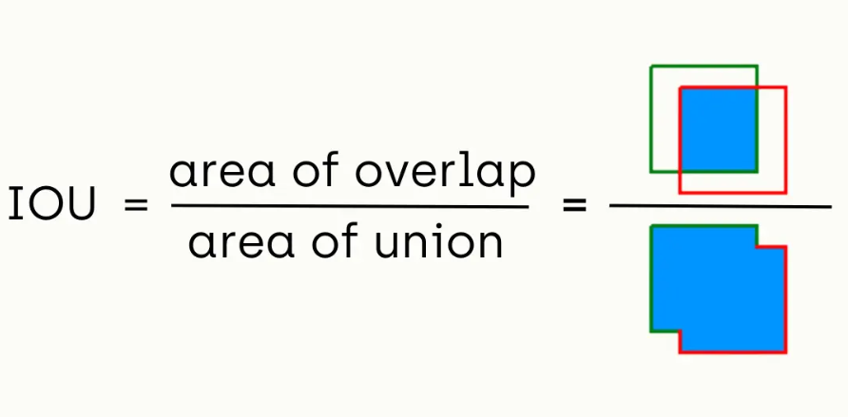
YOLO Algorithm
It measures the overlap between the predicted bounding box (P) and the ground truth bounding box (G)
The IoU score ranges from 0 to 1, where 0 indicates no overlap and 1 indicates a perfect match.
A higher IoU score indicates a more accurate object detection
Intersection over Union (IoU) is a common metric used to evaluate the performance of an object detection algorithm

Slide 7
Process
2

Slide 8
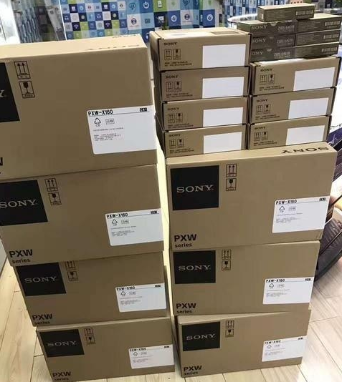
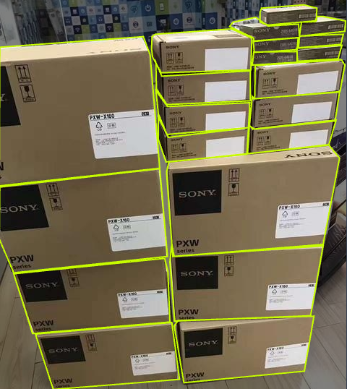
Process
Collect required images
Label the required objects in the images with required classes (using annotation/segmentation tools)
Download the required labelled file
Training the model with pretrained weights
Evaluate the model
Stock Image
Labelled Image

Slide 9
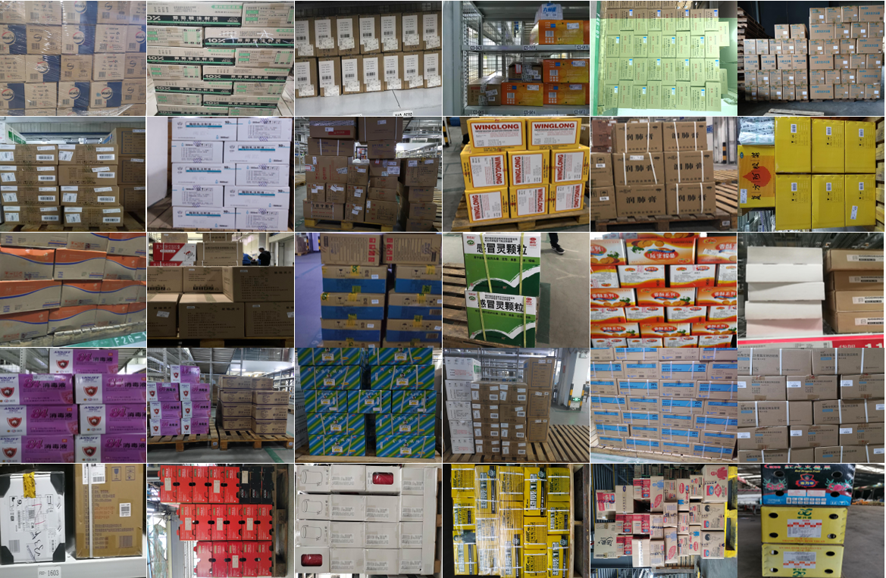
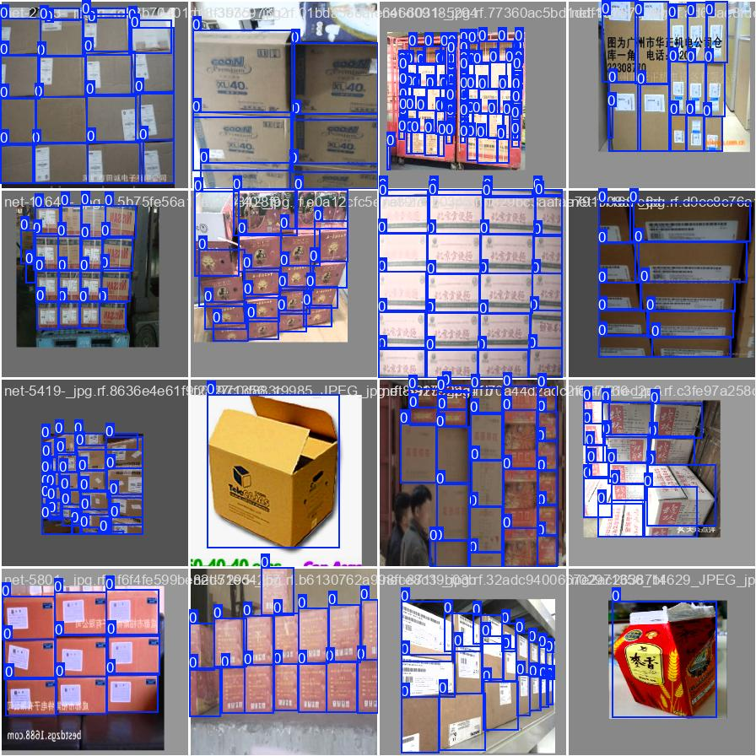
Our Project
Sample Images
Sample Trained Images
We used an online dataset named SDC(Stacked Carton Dataset), a large-scale carton dataset for the research community from GitHub
Trained on this dataset for 60 epochs using YOLOv8s model to evaluate the performance

Slide 10
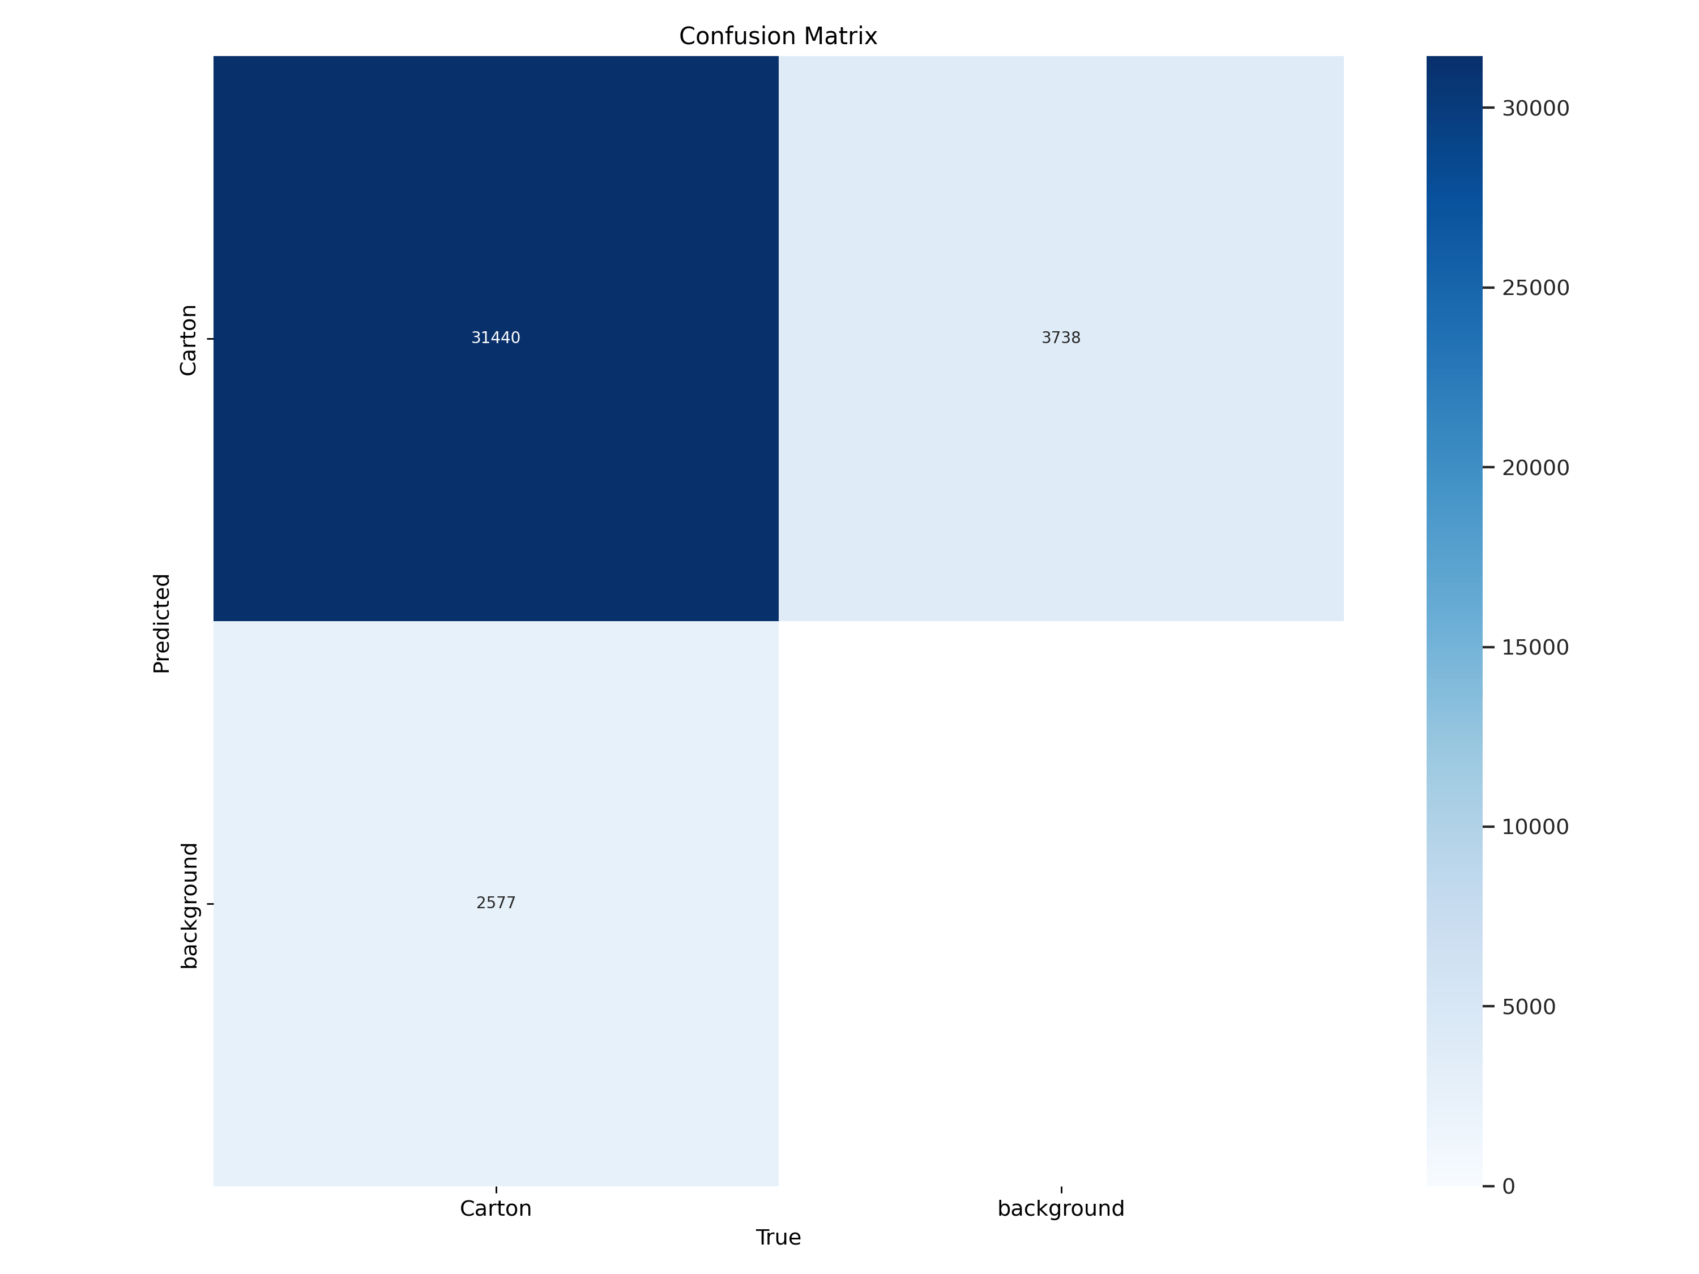
Our Project
Dataset Split
Confusion Matrix
In total there were 8630 images with 37755 instances of cartons in the images.
Training Split = 6123 images
Validation Split = 1670 images
Test Split = 837 images
Confusion matrix shows that the there were 6315 instances where background was identified as Carton boxes

Slide 11
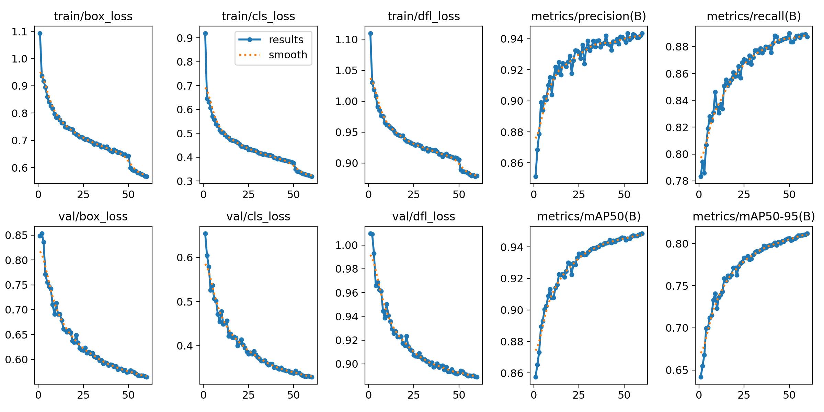
Our Project
Precision - 94.3%
Recall – 88.8%
mAP50 – 94.9%
mAP50-90 – 81.2%
The box loss and the class loss graphs indicate there is still scope for improvement as the loss graphs are still declining and the precision graphs are still rising.

Slide 12
Challenges
3

Slide 13
Challenges in Detection and Classification
Challenges
Solution
Lighting conditions
Noise from the sensor
Overfitting
Processing Power
Data Augmentation
Calibration
Balanced Dataset
Reduced Dataset

Slide 14
Challenges in Training and Cluster Challenges
Challenges faced on CPU:
Training on CPU alone is time consuming as the datasets are huge.
For reference, each epoch took 10Hours for ~9400 images with YOLO V8 Medium.
Challenges faced in Transition to Cluster GPU:
Dependencies version compatibility is a major issue for using Ultralytics as we faced issues with CUDA and torch version compatibility on which we are working on.
So cannot be used while still resolving the issue and when results are required quickly as we had to work on CPU on specific occasions.

Slide 15
Datasets Explored & Training Experiments
4

Slide 16
Datasets Explored Till Date
S.No | Dataset Name | Source | Number of Images | Strength | Limitation | Reason to choose
1 | CV_Bucharest | Roboflow | 437 | Single box Detection | Stacked box, Less Accurate | Test
2 | Carton Detection TAD | Roboflow | 626 | Single box Detection, Accuracy | Stacked box | Semantic Segmentation
3 | Online Stacked Carton Dataset (OSCD) | Research Journal | 8401 | Stacked box | Overfitting | Segmentation
4 | Live Stacked Carton Dataset (LSCD) | Research Journal | 7735 | Stacked box | Overfitting | Segmentation
5 | Dataset from MASON | DMK Images Archive | 400 | Single box Detection | Stacked box, Less Accurate | Test

Slide 17
Training Experiments Performed
S.No | Dataset | Number of Images | YOLO Model | Epochs | mAP (50-95)* | Performance
1 | CV_Bucharest | 437 | Yolo V8 Small | 25 | 71.69% | Slow Detection, Less Accuracy
2 | Online Stacked Carton Dataset (OSCD) | 8401 | Yolo V8 Small | 5 | 75.27% | Slow Detection, Less Accuracy, Overfitting(Identified any rectangular shape as carton box)
3 | Online Stacked Carton Dataset (OSCD) + CV_Bucharest | 8838 | Yolo V8 Small | 60 | 81.19% | Quick Detection, Very Accurate, Overfitting(Identified any rectangular shape as carton box)
4 | Online Stacked Carton Dataset (OSCD) + CV_Bucharest + Carton Detection TAD | 9464 | Yolo V8 Medium | 180 | 83.95% | Quick Detection, Severe Overfitting(Identified any rectangular shape as carton box)
* mAP is the result observed on validation set which is 20% of the total number of images
Note:
1.All the Training is performed with image size 224x224
2.Performance on real test has not been recorded as no metrics were fixed for Live testing

Slide 18
Reference Performance on CPU vs Cluster GPU
Model: YOLO V8 Medium
Processor: Intel(R) Core(TM) i7-10700K CPU @ 3.80GHz
Dataset: ~9400 images
Image size: 224x224 pixels
Time taken for each epoch: 50 Minutes
Image size: 640x640 pixels
Time taken for each epoch: 10 Hours
Model: YOLO V8 Medium
Processor: Nvidia Tesla V 100 16 GB GPU RAM(Cluster)
Dataset: ~9400 images
Image size: 224x224 pixels
Time taken for each epoch: --
Image size: 640x640 pixels
Time taken for each epoch: 50 Minutes
**10 hours on CPU vs 50 Minutes on GPU is drastic improvement in terms of time consumption for the same YOLO model, same dataset, same image size .

Slide 19
Observations from Integration Meeting
5

Slide 20
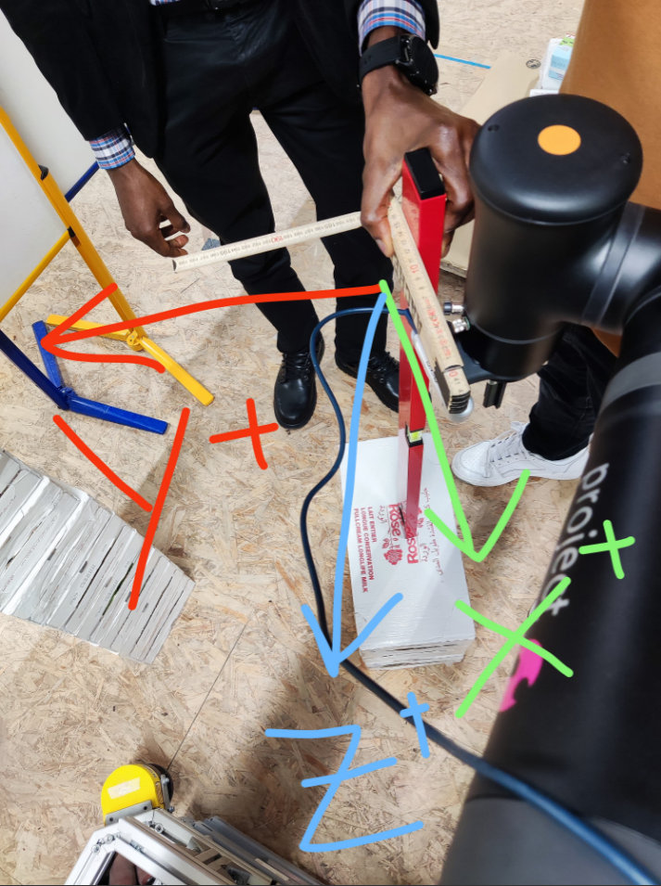
Observations from the Integration meeting
These are main observations from the Integration meeting:
Model is basically overfitting to only detect boxes when there is a label.
Also Stacked boxes are detected as one whole box rather than individual carton boxes.
Performance is inconsistent due to lighting conditions and different Box sizes.
Camera angle is more crucial for detection than the estimated difference.
Different Coordinate systems are required for different positions
Centroid calculation is done based on the position of the carton box in the image and not the actual centroid of the Carton box.**
Fig: Reference Frame or the main Coordinate system at the centre of the depth sensor

Slide 21
Future RoadMap
6

Slide 22
Future RoadMap
Based on the observations from the Integration meeting, these are the work that needs to be done:
Testing should be done on Image, Video, Web Camera and Depth Sensor as the performance is difference on different formats.(Estimated to be high on Images)
Test on Grayscale Images to evaluate the Performance
Train with Augmented Data to check the performance in different Lighting conditions
Address the issue of Stacked boxes being detected as a single carton rather than different boxes**

Slide 23
References
7

Slide 24
References
https://ieeexplore.ieee.org/document/9887678
https://encord.com/blog/yolo-object-detection-guide/
https://arxiv.org/pdf/2102.12808
CV_Bucharest: https://universe.roboflow.com/sdc-labels-convert/cv_bucharest
Carton Detection TAD: https://universe.roboflow.com/crate-tracker/carton-detection-tad
OSCD : https://drive.google.com/file/d/1YeZ4mg_qZ4dBvKKfgGF8RQcyOMNoMp37/view
LSCD: https://drive.google.com/file/d/1JRk_YjPpGcTCB-bvlJ37KsI5Sx1tfbUc/view
Dataset from MASON: https://drive.google.com/drive/folders/1V4JxLJGX99nlcuy4wWkaZERJoVTXLDJ0
Notes:
Clinical Translation and Adoption: Integrating machine learning-based systems into clinical practice involves regulatory, ethical, and practical considerations. Ensuring the safety, reliability, and compliance of these systems, and addressing concerns related to data privacy and security, can be significant hurdles.
Complex Dynamics: The glucose-insulin system is a complex and dynamic physiological process influenced by various factors, such as food intake, physical activity, stress, and other physiological and environmental factors. Capturing and modeling this complexity accurately remains a challenge.

Slide 25
Thank you!

